Slide 1
Unit 9 Linear Regression
Machine Learning
https://www.javatpoint.com/linear-regression-in-machine-learning

Slide 2
Linear Regression in Machine Learning
Linear regression is one of the easiest and most popular Machine Learning algorithms.
It is a statistical method that is used for predictive analysis.
Linear regression makes predictions for continuous/real or numeric variables such as sales, salary, age, product price, etc.

Slide 3
Linear Regression in Machine Learning
Linear regression algorithm shows a linear relationship between a dependent (y) and one or more independent (x) variables, hence called as linear regression.
Since linear regression shows the linear relationship, which means it finds how the value of the dependent variable is changing according to the value of the independent variable.

Slide 4
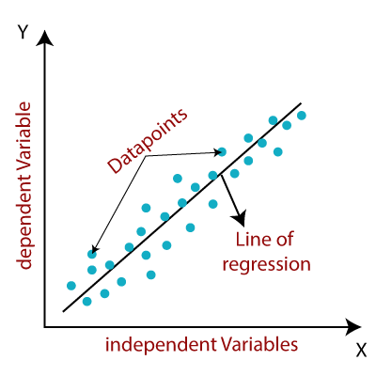
Linear Regression in Machine Learning
The linear regression model provides a sloped straight line representing the relationship between the variables.

Slide 5
Linear Regression in Machine Learning
The values for x and y variables are training datasets for Linear Regression model representation.
y= a0+a1x+ ε
Y= Dependent Variable (Target Variable)
X= Independent Variable (predictor Variable)
a0= intercept of the line (Gives an additional degree of freedom)
a1 = Linear regression coefficient (scale factor to each input value).
ε = random error

Slide 6

Types of Linear Regression
Linear regression can be further divided into two types of the algorithm:
  Simple Linear Regression:
    If a single independent variable is used to predict the value of a numerical dependent variable, then such a Linear Regression algorithm is called Simple Linear Regression.

Slide 7
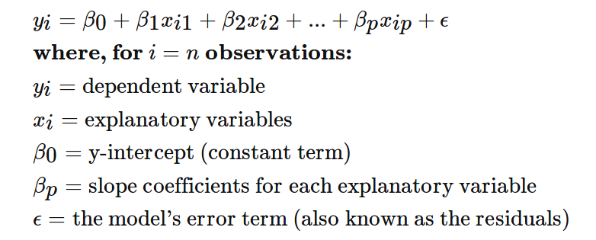
Types of Linear Regression
Multiple Linear regression:
  If more than one independent variable is used to predict the value of a numerical dependent variable, then such a Linear Regression algorithm is called Multiple Linear Regression.

Slide 8
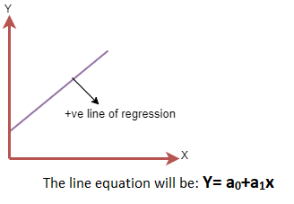
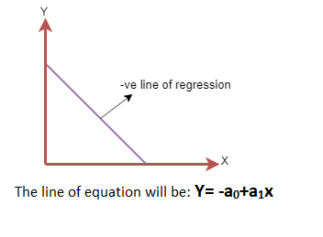
Linear Regression Line
A linear line showing the relationship between the dependent and independent variables is called a regression line.
A regression line can show two types of relationship:
Notes:
Positive Linear Relationship:
If the dependent variable increases on the Y-axis and independent variable increases on X-axis, then such a relationship is termed as a Positive linear relationship.
Negative Linear Relationship:
If the dependent variable decreases on the Y-axis and independent variable increases on the X-axis, then such a relationship is called a negative linear relationship.

Slide 9
Finding the best fit line
The best fit line that means the error between predicted values and actual values should be minimized.
The best fit line will have the least error.
The different values for weights or the coefficient of lines (a0, a1) gives a different line of regression,
The best values for a0 and a1 to find the best fit line, so to calculate this we use cost function.
Notes:
When working with linear regression, our main goal is to find the best fit line that means the error between predicted values and actual values should be minimized.
The best fit line will have the least error.
The different values for weights or the coefficient of lines (a0, a1) gives a different line of regression, so we need to calculate the best values for a0 and a1 to find the best fit line, so to calculate this we use cost function.

Slide 10
Cost function
The cost function is used to estimate the values of the coefficient for the best fit line.
Cost function optimizes the regression coefficients or weights.
It measures how a linear regression model is performing.

Slide 11
Cost function
The cost function is used to find the accuracy of the mapping function.
The mapping function maps the input variable to the output variable.
This mapping function is also known as Hypothesis function.

Slide 12

Cost function
Mean Squared Error (MSE) - cost function is the average of squared error occurred between the predicted values and actual values.
N=Total number of observation
Yi = Actual value
(a1xi+a0)= Predicted value.

Slide 13
Cost function
Residuals: The distance between the actual value and predicted values is called residual.
If the observed points are far from the regression line, then the residual will be high, and so cost function will high.
If the scatter points are close to the regression line, then the residual will be small and hence the cost function.

Slide 14
Cost function
Gradient Descent:
  Gradient descent is used to minimize the MSE by calculating the gradient of the cost function.
  A regression model uses gradient descent to update the coefficients of the line by reducing the cost function.
  It is done by a random selection of values of coefficient and then iteratively update the values to reach the minimum cost function.

Slide 15
Model Performance
The Goodness of fit determines how the line of regression fits the set of observations.
The process of finding the best model out of various models is called optimization.

Slide 16
R-squared method
R-squared is a statistical method that determines the goodness of fit.
It measures the strength of the relationship between the dependent and independent variables on a scale of 0-100%.
The high value of R-square determines the less difference between the predicted values and actual values and hence represents a good model.

Slide 17

R-squared method
It is also called a coefficient of determination, or coefficient of multiple determination for multiple regression.

Slide 18
Assumptions of Linear Regression
Below are some important assumptions of Linear Regression.
These are some formal checks while building a Linear Regression model, which ensures to get the best possible result from the given dataset.
Linear relationship between the features and target:
  Linear regression assumes the linear relationship between the dependent and independent variables

Slide 19
Assumptions of Linear Regression
Small or no multicollinearity between the features:
  Multicollinearity means high-correlation between the independent variables.
  Due to multicollinearity, it may difficult to find the true relationship between the predictors and target variables.

Slide 20
Assumptions of Linear Regression
Small or no multicollinearity between the features:
  Or we can say, it is difficult to determine which predictor variable is affecting the target variable and which is not.
  So, the model assumes either little or no multicollinearity between the features or independent variables.

Slide 21
Assumptions of Linear Regression
Homoscedasticity Assumption:
  Homoscedasticity is a situation when the error term is the same for all the values of independent variables.
  With homoscedasticity, there should be no clear pattern distribution of data in the scatter plot.

Slide 22
Assumptions of Linear Regression
Normal distribution of error terms:
  Linear regression assumes that the error term should follow the normal distribution pattern.
  If error terms are not normally distributed, then confidence intervals will become either too wide or too narrow, which may cause difficulties in finding coefficients.
  It can be checked using the q-q plot. If the plot shows a straight line without any deviation, which means the error is normally distributed.

Slide 23
Assumptions of Linear Regression
No autocorrelations:
  The linear regression model assumes no autocorrelation in error terms.
  If there will be any correlation in the error term, then it will drastically reduce the accuracy of the model.
  Autocorrelation usually occurs if there is a dependency between residual errors.

Slide 24
Simple Linear Regression in Machine Learning
Simple Linear Regression is a type of Regression algorithms that models the relationship between a dependent variable and a single independent variable.
The relationship shown by a Simple Linear Regression model is linear or a sloped straight line, hence it is called Simple Linear Regression.

Slide 25
Simple Linear Regression in Machine Learning
The key point in Simple Linear Regression is that the dependent variable must be a continuous/real value.
However, the independent variable can be measured on continuous or categorical values.

Slide 26
Simple Linear Regression in Machine Learning
Simple Linear regression algorithm has mainly two objectives:
  Model the relationship between the two variables. Such as the relationship between Income and expenditure, experience and Salary, etc.
  Forecasting new observations. Such as Weather forecasting according to temperature, Revenue of a company according to the investments in a year, etc.

Slide 27
Simple Linear Regression Model
The Simple Linear Regression model can be represented using the below equation:
y= a0+a1x+ ε
a0= It is the intercept of the Regression line (can be obtained putting x=0)
a1= It is the slope of the regression line, which tells whether the line is increasing or decreasing.
ε = The error term. (For a good model it will be negligible)

Slide 28
Multiple Linear Regression
Simple Linear Regression, where a single Independent/Predictor(X) variable is used to model the response variable (Y).
More than one predictor variable; the Multiple Linear Regression algorithm is used.
Multiple Linear Regression takes more than one predictor variable to predict the response variable.
Notes:
In the previous topic, we have learned about Simple Linear Regression, where a single Independent/Predictor(X) variable is used to model the response variable (Y). But there may be various cases in which the response variable is affected by more than one predictor variable; for such cases, the Multiple Linear Regression algorithm is used.
Moreover, Multiple Linear Regression is an extension of Simple Linear regression as it takes more than one predictor variable to predict the response variable. We can define it as:

Slide 29
Multiple Linear Regression
Multiple Linear Regression is the linear relationship between a single dependent continuous variable and more than one independent variable.
Prediction of CO2 emission based on engine size and number of cylinders in a car.
Notes:
Multiple Linear Regression is one of the important regression algorithms which models the linear relationship between a single dependent continuous variable and more than one independent variable.

Slide 30
Some key points about MLR
For MLR, the dependent or target variable(Y) must be the continuous/real, but the predictor or independent variable may be of continuous or categorical form.
Each feature variable must model the linear relationship with the dependent variable.
MLR tries to fit a regression line through a multidimensional space of data-points.

Slide 31
MLR equation:
In Multiple Linear Regression, the target variable(Y) is a linear combination of multiple predictor variables x1, x2, x3, ...,xn.
Y= b0 +b1x1 + b2x2 + b3x3 +...+ bnxn
Y= Output/Response variable
b0, b1, b2, b3 , ..., bn = Coefficients of the model.
x1, x2, x3, x4,...= Various Independent/feature variable
Notes:
In Multiple Linear Regression, the target variable(Y) is a linear combination of multiple predictor variables x1, x2, x3, ...,xn.
Since it is an enhancement of Simple Linear Regression, so the same is applied for the multiple linear regression equation, the equation becomes:

Slide 32
Assumptions for Multiple Linear Regression:
A linear relationship should exist between the Target and predictor variables.
The regression residuals must be normally distributed.
MLR assumes little or no multicollinearity (correlation between the independent variable) in data.

Slide 34
Implementation of Simple Linear Regression Algorithm using Python
Problem Statement example for Simple Linear Regression:
  Here we are taking a dataset that has two variables: salary (dependent variable) and experience (Independent variable).

Slide 35
Implementation of Simple Linear Regression Algorithm using Python
Problem Statement example for Simple Linear Regression:
  The goals of this problem is:
    We want to find out if there is any correlation between these two variables
    We will find the best fit line for the dataset.
    How the dependent variable is changing by changing the independent variable.

Slide 36
Implementation of Simple Linear Regression Algorithm using Python
In this section, we will create a Simple Linear Regression model to find out the best fitting line for representing the relationship between these two variables.
To implement the Simple Linear regression model in machine learning using Python, we need to follow the below steps:
  Step-1: Data Pre-processing

Slide 37
Implementation of Simple Linear Regression Algorithm using Python
Step-1: Data Pre-processing
  The first step for creating the Simple Linear Regression model is data pre-processing.
  We have already done it earlier in this tutorial. But there will be some changes, which are given in the below steps:
  First, we will import the three important libraries, which will help us for loading the dataset, plotting the graphs, and creating the Simple Linear Regression model.

